Slide 1
A WORKSHOP FOR YOUR FUTURE
http://www.units.it

Slide 2
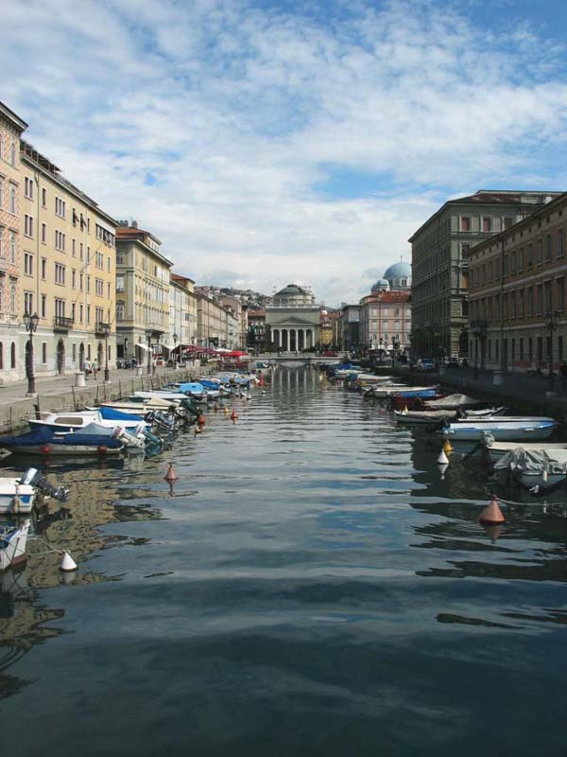
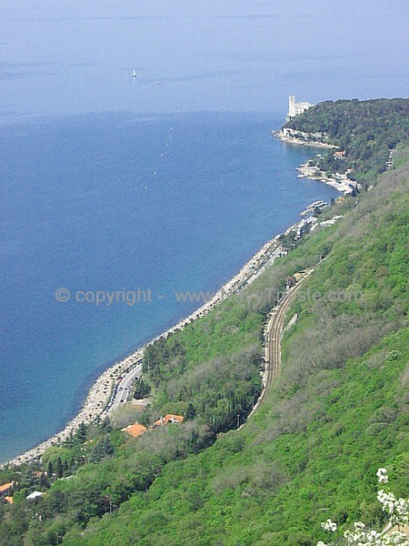
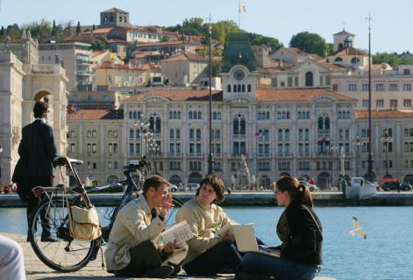
Trieste: A journey into the sea of knowledge
In 1924 the School of Commerce, set up in 1877 by Baron Pasquale Revoltella, was granted the title of Royal University of Economics and Business Studies of Trieste.
In 1938 the name of the University was changed to “Regia Università degli Studi” (Royal University of Trieste)

Slide 3
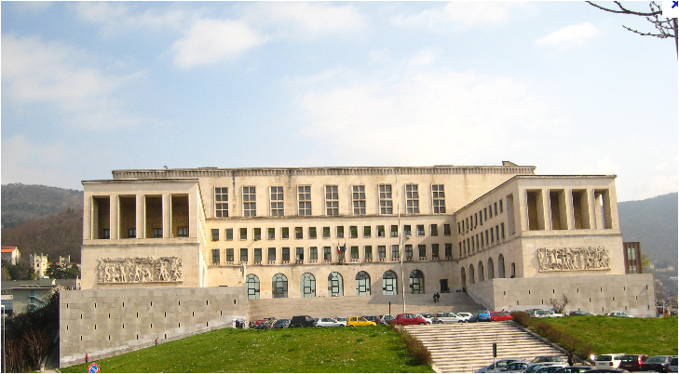

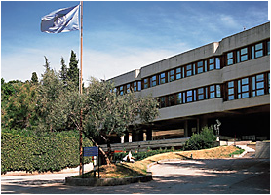
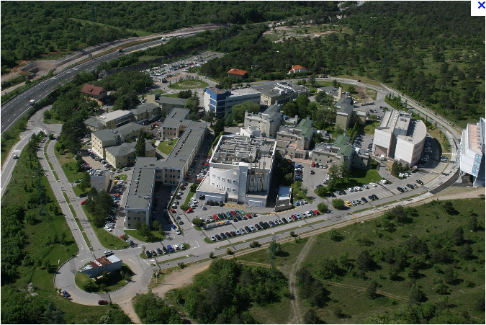
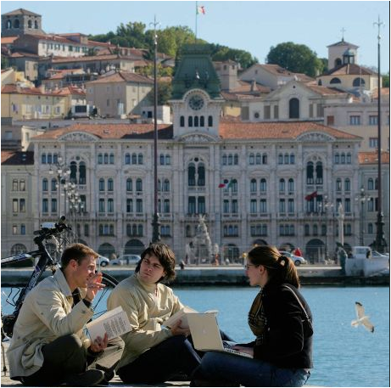
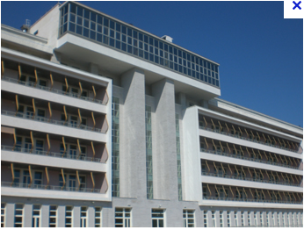
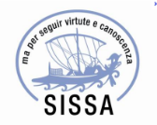
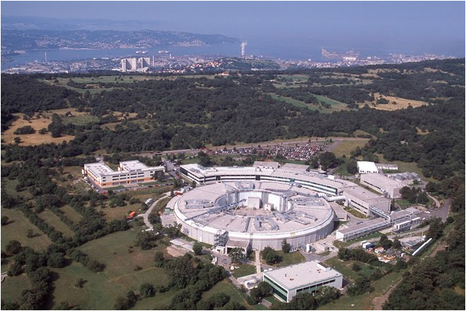
A Network of scientific institutions

Slide 4
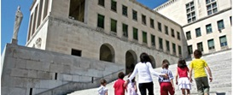
Trieste System
TWAS
Thirld World
Academy of Science
ICTP
International Centre
For Theoretical
Physics
CBM
Molecular Medicine
ICS
International Centre
For Science and
High Technology
ICGEB
International Centre
For Genetics and
Biotechnology
Trieste
University
SISSA
OGS
National Institute
For Oceanography and
Exp. Geophysics
Elettra
Synchrotron
ISMAR-CNR
Marine Science
Over 30 researchers every 1,000 active citizens (8.1 in USA, 9.1 in Japan, 5.7 in Europe)
Area
Science Park
TASC
Surface Physics
INFN
Nuclear Physics
INAF
Astrophysics
Astronomy
1841
Osservatorio Marittimo
1898
Osservatorio Astronomico
1924-1938 Università
1981 Area di Ricerca
1978 SISSA
1993 ELETTRA
1987 ICGEB
1964 ICTP
1983TWAS
1850
1900
2000

Slide 5
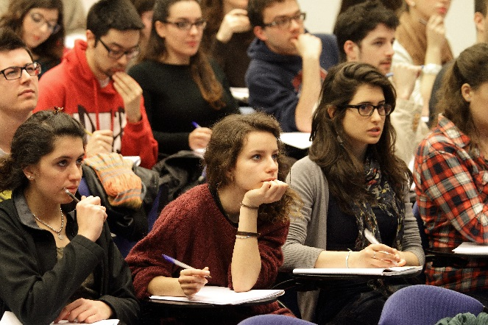
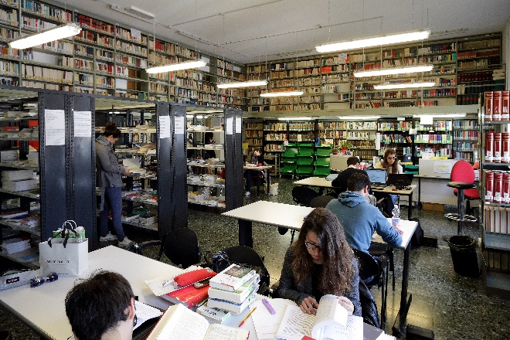
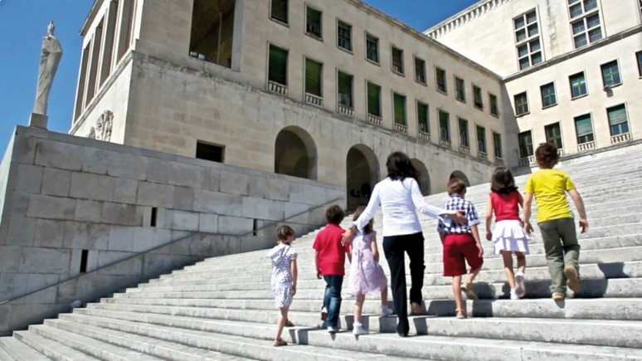
University of Trieste
Personnel
  700 academics
  2000 active scientists staff, PhD students, PostDocs, guest scientists)
  711 technical/administration
  Students
  19.000 (bachelor, master)
  8.3 % from abroad
  58.6% employed after 1 year
  1300 post-lauream
  434 PhD students
  400 medical interns
Departments
  Chemistry and Pharmacy
  Economics
  Engineering and Architecture
  Humanities
  Law, Language, Interpretation and Translation
  Life Sciences
  Health Sciences
  Mahematics and Geosciences
  Physics
  Political Sciences

Slide 6
Facts and figures
70 Bachelor and Master Degree Programmes;
15 PhD courses and Schools
29 Specialization courses (mostly in Medicine)
9 Short Masters for vocational training and advanced studies
3,000 Agreements for work placements
377 Bilateral Agreements for International Student Mobility

Slide 7
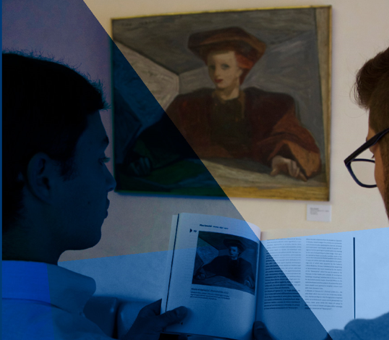
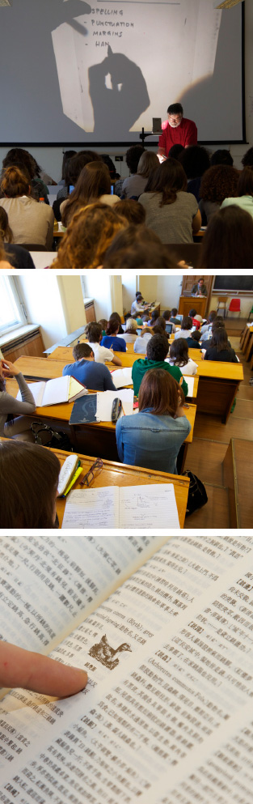
Social Sciences and Humanities
Economics, Business Administration, Statistics
Humanities
Political and Social Sciences,
Law
Languages, Interpreting and Translation

Slide 8
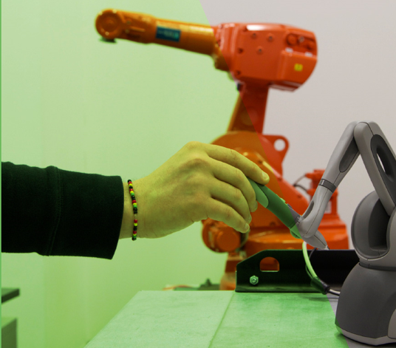
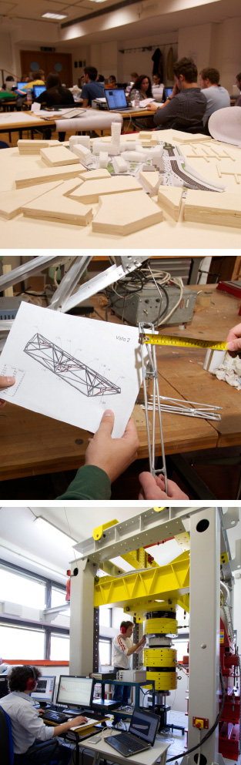
Physical Sciences and Engineering
  Engineering
  Architecture
  Physics
  Mathematics
  Earth Sciences
  Chemistry and Pharmacy

Slide 9
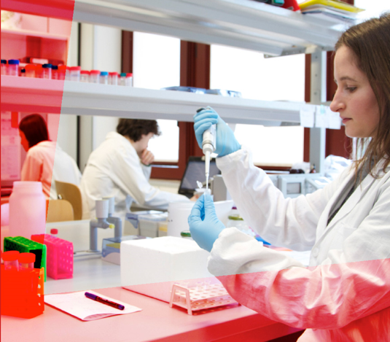
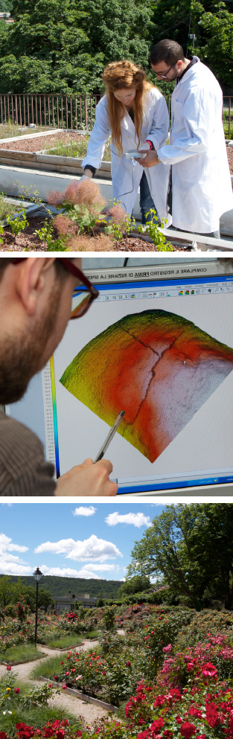
Life Sciences
Biology & Biotechnology
Psychology
Medical, Surgery and Health Sciences

Slide 10
Rankings
In the top 10 italian universities by Higher Education Evaluation & Accreditation Council di Taiwan (HEEACT)
  Ranked 291° in the best 500 University in the world.
  Source: HEEACT 2012
Ranked 3° italian university among the 14 included by Times Higher Education
  Ranked 271° in the best 500 University in the world

Slide 11
International
95
Staff
100
Visiting researchers
1800
Students
300 (more)
Incoming students
800
Short term visits

Slide 12
International Collaboration
Over thirty years of collaboration between the Moscow State Linguistic University and the Section of Russian Language of the Department of Legal, Language, Interpreting and Translation Studies.
Exchange of students and teachers of Russian and Italian Languages. Supervisor: Prof. Ivan Verc.
Collaboration between the University of Ingeneering and Economics of St. Petersburg– ENGECON and the Department of Scienze Economiche Aziendali, Matematiche e Statistiche.
Exchange of students and teachers in the field of Economics Supervisor: Gianluigi Gallenti.

Slide 13
International Collaboration
Collaboration between the Moscow State University for International Relations (MGIMO) and the Master Degree in International and Diplomatic Sciences (Gorizia).
Exchange of students and teachers.
Supervisor: Prof. Piergiorgio Gabassi.
Collaboration between the Academy of Science - International Institute for Earthquake Prediction Theory (IIEP) and the Department of Mathematics and Geosciences in the field of geophysiscs and earthquake prediction.
Exchange of researchers.
Supervisor: Prof. Giuliano Panza.

Slide 14
International Collaboration
Collaboration between the Academy of Sciences di Novosibirsk and the Department of Life Sciences in the field of botanical biodiversity.
Scientific collaboration and exchange of researchers
Supervisor: Prof. Pierluigi Nimis.
Collaboration between the Shemyakin-Ovchinnikov Institute of Bioorganic Chemistry, Russian Academy of Sciences, Moscow, the Institute for Experimental Medicine of St. Petersburg and the Department of Life Sciences in the field of immunology.
Scientific collaboration and exchange of researchers.
Supervisor: prof. Alessandro Tossi.

Slide 15
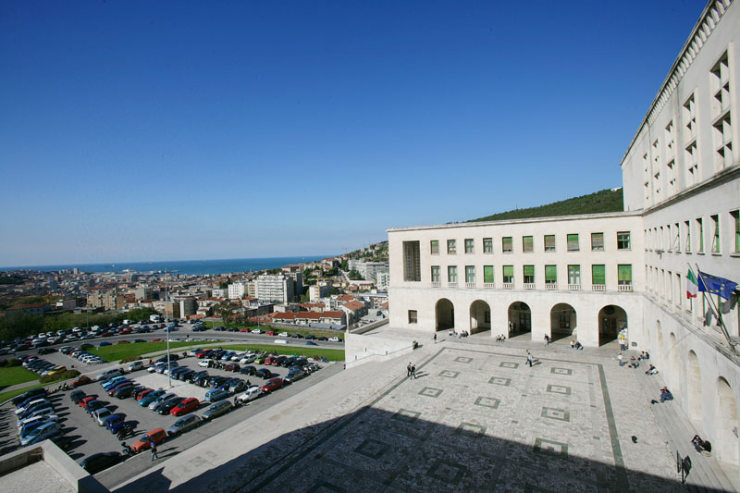
Thank you for attention

