Slide 1
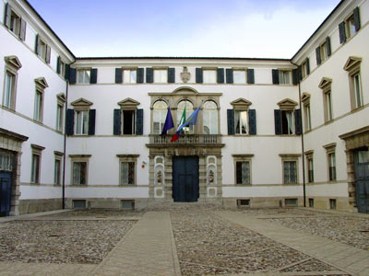
International scientific-practical conference
«Formation of expert community in the fields of education, science and technologies»
Trieste - September 26, 2013

Slide 2



Short history
The University of Udine was founded in 1978 as part of the reconstruction plan of Friuli after the earthquake in1976. Its aim was to provide the community with an independent center for advanced training in cultural and scientific studies.
Facts and figures
14 departments
16,400 students enrolled
462 PhD students
704 teachers and researchers (permanent positions)
547 technical and administrative staff (permanent positions)
14 PhD courses
35 associates and linguistic experts
Facts and figures
Academic programs a.y. 2013-2014
35 courses of Bachelor's Degree (2 in cooperation with other universities)
32 courses Master Degree (7 in cooperation with other universities)
3 courses Degree single-cycle.

Slide 3
REVENUES FOR RESEARCH ACTIVITIES PER DEPARTMENT - 2012
Central administration | 1.126.489,64 €
Dept. of agriculture and environmental sciences | 5.438.890,09 €
Dept. of electric, mechanic and management engineering | 3.241.165,71 €
Dept. of medical and biological sciences | 2.974.085,77 €
Dept. of food sciences | 2.083.804,13 €
Dept. of chemistry, physics and environment | 1.465.707,18 €
Dept. of history and cultural heritage preservation | 1.044.421,56 €
Dept. of mathematics and informatics | 847.224,76 €
Dept. of civil engineering and architecture | 667.716,31 €
Dept. of economic and statistical sciences | 599.997,55 €
Dept. of human sciences | 386.907,00 €
Dept. of foreign languages and literatures | 116.600,00 €
Dept. of legal sciences | 112.479,00 €
Dept. of experimental and clinical medicine | 23.173,00 €
Dept. of humanities | 9.428,29 €
Experimental farm A Servadei | 98.394,17 €
TOTAL REVENUES FOR RESEARCH ACTIVITIES | 20.236.484,16 €
Research funding

Slide 4
REVENUES FOR RESEARCH ACTIVITIES PER DEPARTMENT - 2012
Research funding

Slide 5
Revenues for research activities 2012 - % for macro areas
Research funding

Slide 6
ERC sub-panels where UNIUD is mostly active in research project proposals
Social Sciences and Humanities (SH)
Research funding

Slide 7
ERC sub-panels where UNIUD is mostly active in research project proposals
Life Sciences (LS)
Research funding

Slide 8
ERC sub-panels where UNIUD is mostly active in research project proposals
Physical Engineering (PE)
Research funding

Slide 9
Revenues for research activities: public and private funders 2012 in €
Funder | Central administration | Experimental Farm | Departments | Total
Enterprises | 350.675,26 | 27.128,00 | 4.891.819,04 | 5.269.622,30
Other public bodies | 79.201,09 | 14.344,00 | 3.553.741,67 | 3.647.286,76
Ministries | 455.174,58 | 0,00 | 3.060.218,39 | 3.515.392,97
EU | 56.528,93 | 0,00 | 2.768.500,00 | 2.825.028,93
Region FVG | 130.435,00 | 50.000,00 | 1.880.429,85 | 2.060.864,85
Other private bodies | 11.474,78 | 913,67 | 1.527.531,40 | 1.539.919,85
Consortium | 0,00 | 6.008,50 | 706.850,00 | 712.858,50
Provinces | 43.000,00 | 0,00 | 546.782,67 | 589.782,67
Municipalities | 0,00 | 0,00 | 66.299,04 | 66.299,04
Total |  |  |  | 20.227.055,87
Research funding

Slide 10
Revenues for research activities: % for private research contracts and public funding
Technological and scientific macro area
Socio – economic macro area
Research funding
Humanities macro area
Medical macro area

Slide 11
EU countries from which UNIUD gets research contracts
Research funding

Slide 12




2007-2013
EU funded research
2014-2020

Slide 13
UNIUD participation in EU projects 2007-2013
Projects submitted
EU projects submitted and funded
Projects funded

Slide 14
For a border region like Friuli Venezia Giulia cross border cooperation is of strategic importance. For such reason UNIUD is strongly involved in cross border cooperation projects in many different research fields.
12 out of 14 departments are running an Interreg project.
Projects submitted
Projects funded
Interreg projects submitted and funded
Programme | 2012
ITALIA AUSTRIA | 7
ITALIA SLOVENIA | 18
SOUTH EST EUROPE | 1
ALPIN SPACE | 1
IPA ADRIATIC | 1
CENTRAL EUROPE | 1
Total | 29

Slide 15
Patent applications and licencing
Technology transfer

Slide 16
Costs and revenues of UNIUD patents portfolio
Technology transfer

Slide 17
UNIUD has totally 30 spin off: here is the split of spin off in different disciplinary areas
Mathematics and informatics 6%
Medical sciences 6%
History, philosophy, pedagogy and psychology 3%
Physics 3%
Technology transfer
Economic and statistical sciences 3%
Industrial and information engineering 40%
Civil engineering and architecture 6%
Agriculture and veterinary 33%

Slide 18
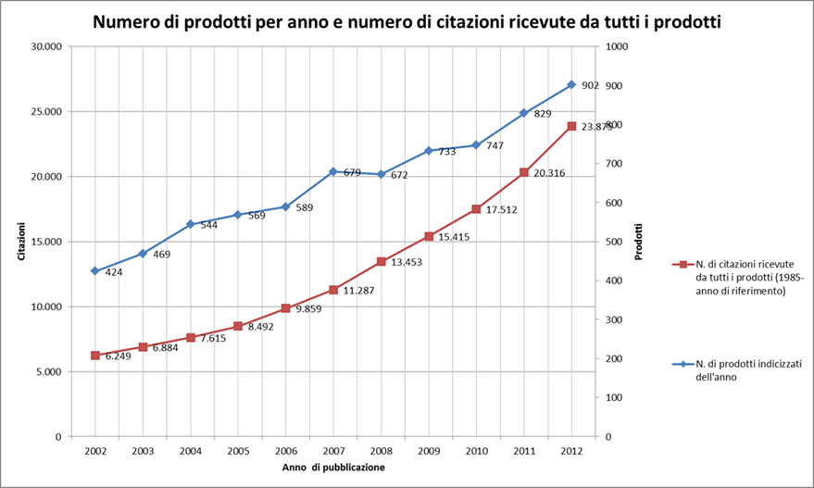
Indexed publications in Web Of Science and citations per year from 1985
Publications

Slide 19
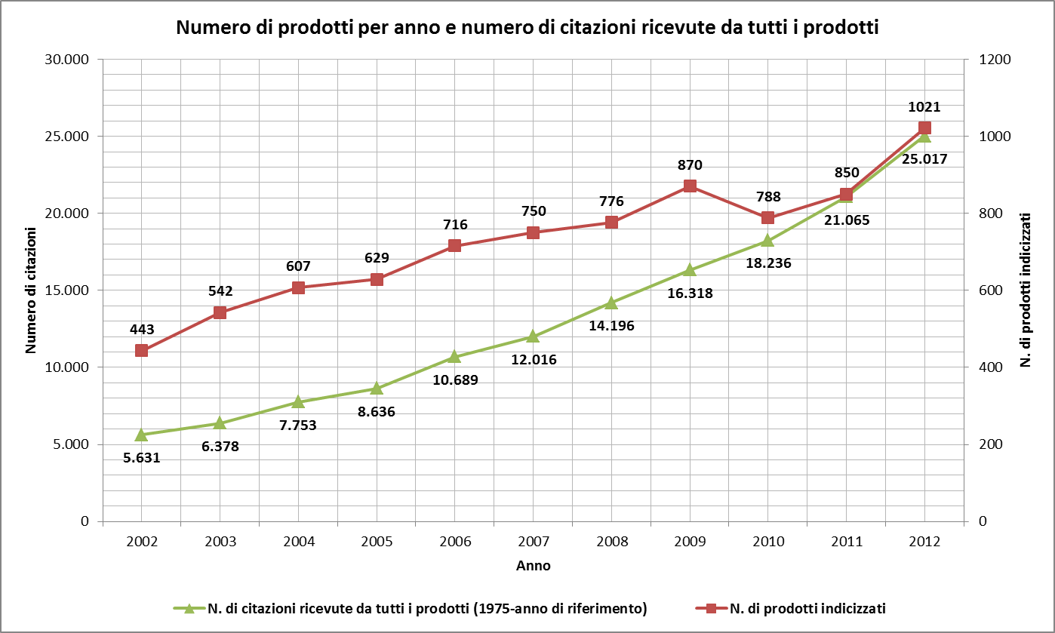
Indexed publications in Scopus and citations per year from 1975
Publications

Slide 20
Indexed number of products per publication typology in Web of Science (2002-2012)
Publication typology | Arts & Humanities Citation Index | Science Citation Index Expanded | Social Sciences Citation Index | Total
ART EXHIBIT REVIEW | 2 |  |  | 2
ARTICLE | 60 | 5.236 | 335 | 5.631
BIOGRAPHICAL ITEM | 3 | 7 | 2 | 12
BOOK CHAPTER |  | 5 |  | 5
BOOK REVIEW | 85 | 3 | 3 | 91
CORRECTION |  | 23 |  | 23
EDITORIAL MATERIAL | 2 | 158 | 20 | 180
LETTER |  | 157 | 3 | 160
MEETING ABSTRACT | 2 | 866 | 44 | 912
PROCEEDINGS PAPER | 2 | 568 | 20 | 590
REVIEW | 2 | 427 | 18 | 447
SOFTWARE REVIEW | 1 | 1 |  | 2
Total | 159 | 7.451 | 445 | 8.055
Source: own processing from WOS Thomson-Reuters data updated to 10 june 2013
Publications
Indexed number of products per publication typology in Scopus (2002-2012)
Publication typology | N. of products
Article | 5.546
Conference Paper | 1.421
Review | 584
Letter | 205
Editorial | 120
Article in Press | 57
Erratum | 24
Note | 19
Short Survey | 16

Slide 21
Publications indexed in SCOPUS in year divided into disciplinary areas
Publications

Slide 22
UNIUD has been classified at the 8° place among all big Italian universities by the national Agency for Research Evaluation (ANVUR).
The evaluation takes in consideration all relevant research aspects (projects, publications, technology transfer etc….) of the period 2004/2010.
The following table indicates for each area of research the position of UNIUD among all the 32 big Italian Universities
Research area | Position
Medical sciences | 9°
Mathematics and informatics | 3°
Antiquities, Philological-Literary and historical-artistic sciences | 3°
Biological sciences | 12°
Industrial and information engineering | 6°
History, philosophy and pedagogy | 9°
Agricultural and veterinary sciences | 4°
Legal sciences | 16°
Physical sciences | 10°
Economic and statistical sciences | 16°
Civil engineering | 16°
Chemical sciences | 15°
Architecture | 21°
Psychology | 10°
Hearth sciences | 10°
Social and political sciences | 26°

