Slide 1
VIRTUAL BRAINSTORMING
Prof. Klimenko S.V.*, Prof. Raikov A.N.**
* The Institute of Computing for Physics and Technology, Protvino, Russia, Stanislav.Klimenko@gmail.com
** Institute of Control Sciences RAS, Russia
Moscow, Russia, Alexander.N.Raikov@gmail.com
2013

Slide 2
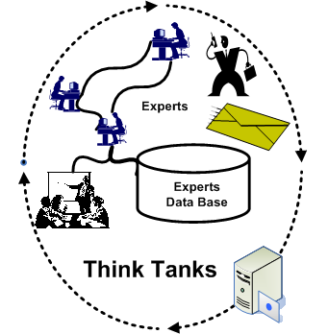
Networking Group
Brainstorming for forecasting
R&D results
Methods
Electronic brainstorming
Collective intelligence
Artificial intelligence
Inverse problem solution
Analytic hierarchy
Cognitive Simulation
Cloud services
Virtual Collaboration
Strategic conversation
Data-mining, etc .
Speeding-up experts consent achievement

Slide 3
Influences of Qualitative Factors
Trust,
Wishes,
Emotions,
Thoughts,
Feelings,
Expectations,
Conflicts,
Targets
Obligations,
Responsibility, etc.
Can not be formalized!

Slide 4
Approaches to Make the Brainstorming
Process Convergent
Stability
Purposefulness
Quantum semantic
Virtual Collaboration

Slide 5
Stability - from Thermodynamic
P*P’+(S_{int}–S_{exch})*(S_{int}’–S_{exch}’)< 0
S_{exch} - exchange information
with an environment (CHAOTIC nature)
Broad
P –GEOMETRIC
nature
S_{int} - CHAOTIC nature

Slide 6
Purposefulness – from Invers Problem Solution method (1)
x = A⁻¹y_{δ}
Path :
A⁻¹
y_{δ}
Y
x
X
∩
∩
Resource: X
Goal: Y
A
Problem

Slide 7
Purposefulness – from Invers Problem Solution Method (2)
Goal
Separable
y_{δ}
Y
∩
A
The close
reflection
graphic
Consent
process
x
∩
X
Resources
Be-Compact

Slide 8
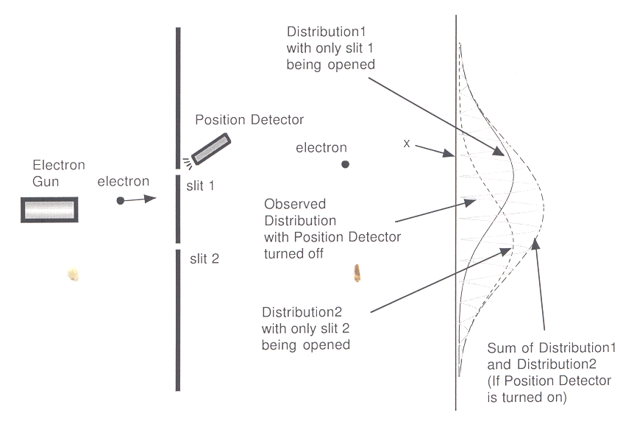
Quantum semantic
Distribution 1
With only slit 1 being opened
Meanings,
Associations,
Synonyms,
Denotation,
Objects,
Antonyms, etc.
Slit 1
Position Detector
Electron
Word
Electron Screen
Word
Sign = Particle
Observed Distribution with
Position Detector turned off
Concept= Wave
Щель 2
Slit 2
Distribution 2
With only slit 2 being opened
Sum of Distribution 1 and Distribution 2
(if Position Detector turn on)

Slide 9
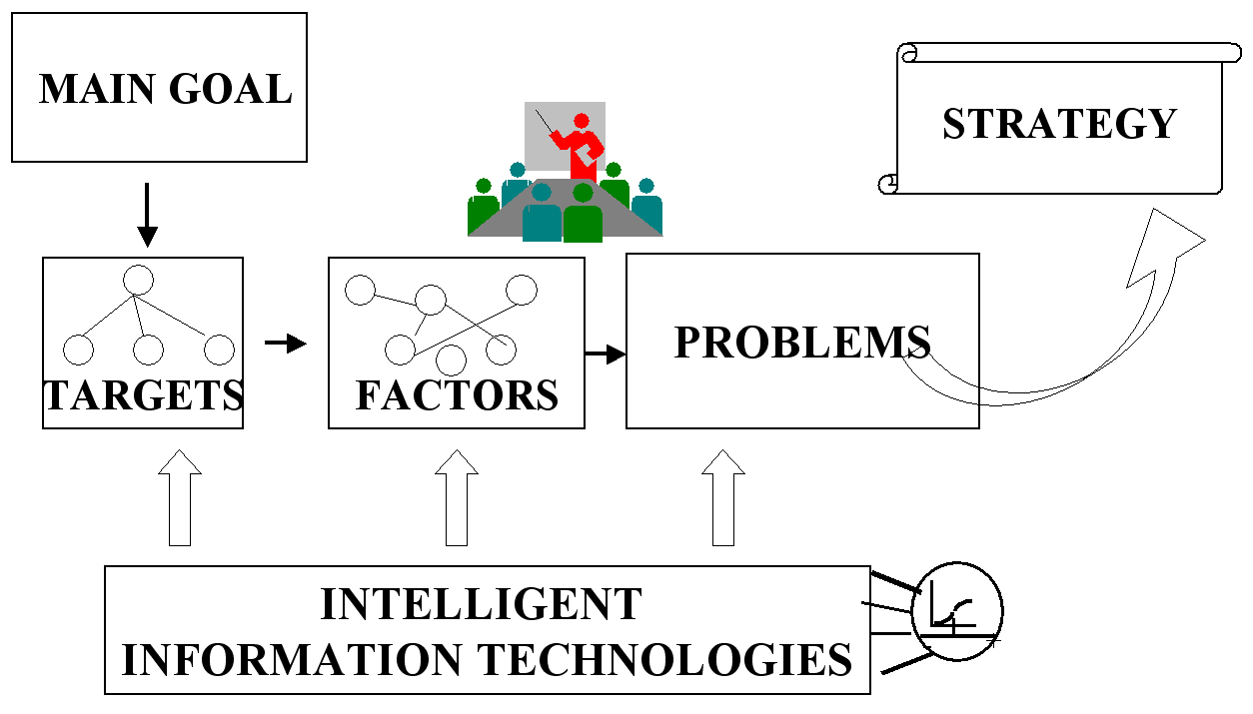
Brainstorming Steps

Slide 10
Recommendations for Moderator
of Brainstorming
Separate goals, resources and actions;
Goals should be categorized as hierarchy goals tree with levels: main, internal and external;
Variety of means should be separated into finite number of parts;
Control all aspects of problems’ solution, bindings between goals and resources;
Never underestimate small factors, etc.

Slide 11
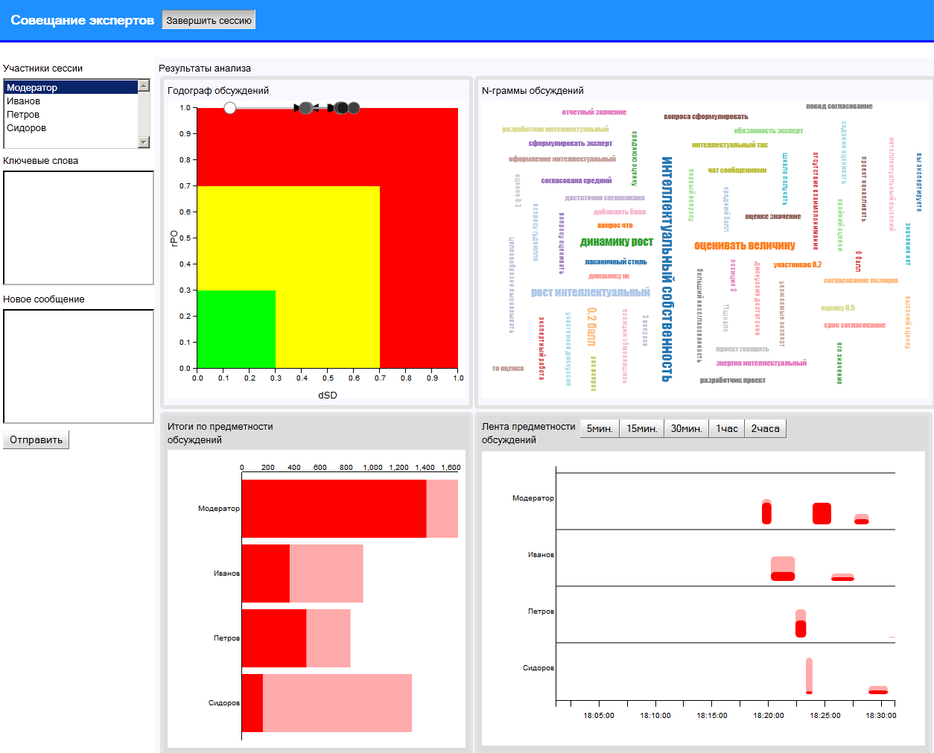
Visual Collaboration (Charts’ Statistic)

Slide 12
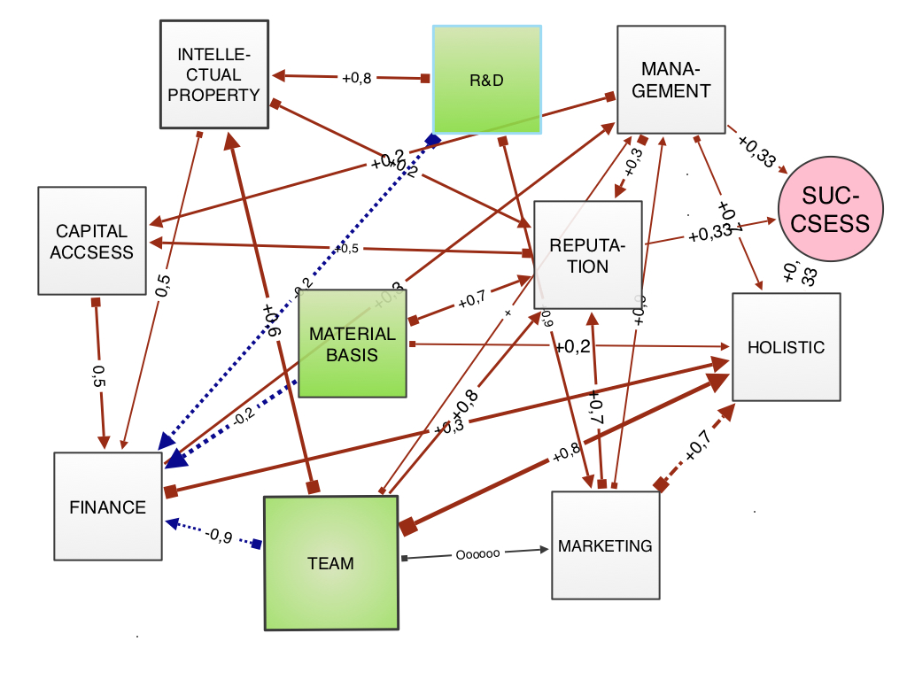
Forecasting R&D Success
with Cognitive Simulation

Slide 13
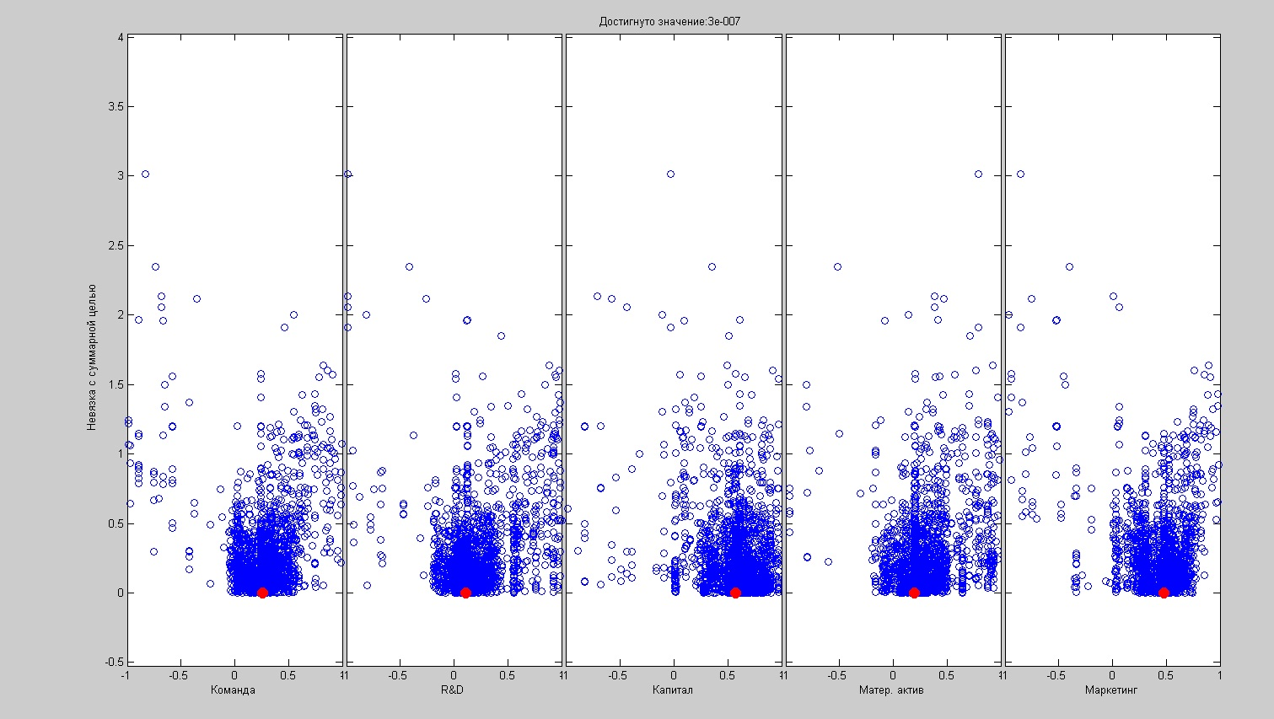
Solution of the Inverse Problem
with Genetic Algorithm
Recommended actions

Slide 14
Modeling System Control Panel

Slide 15
Real Practice and Projects
Administration of the Russian President
Ministry of Education of Russia
Development Strategies: Russian market of information technologies, Russian-Israel science partnership;
Strategies of development in the fields of high and professional education, public health service, social security, housing and communal services, youth policy, religion policy of Russia’s regions;
Strategies of commercial companies such as: Tumen Oil Company, Kursky Bearing Plant, Cheboksary Electrohardware factory, etc .

Slide 16
THANK YOU!
Prof. Klimenko S.V.*, Prof. Raikov A.N.**
* The Institute of Computing for Physics and Technology, Protvino, Russia, Stanislav.Klimenko@gmail.com
** Institute of Control Sciences RAS, Russia
Moscow, Russia, Alexander.N.Raikov@gmail.com

